Slide 1

What makes your Home a must-buy?
The most influential factors to consider when selling your home

Slide 2
Overview
Predictive Model built for this data set is able to predict home prices with an 87% confidence rate.
Features included in the model were decided by how much they influence the price
Features selected for model:
Year Built
Waterfront View
Zip Code
Living Space(Square Feet)
Lot Size(Square Feet)
Home Condition

Slide 3
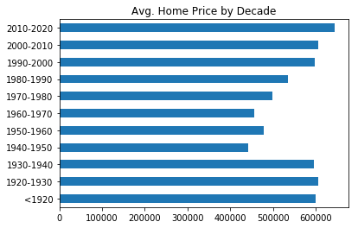
Influential Factor: Year Built
Homes built prior to 1940 and after 1970 seem to have a high value on average.
Time periods <1920-1940 and 2000-2020 approximate to roughly the same Average price for home value
Homes built during 1940-1990 can possibly be sold for more if home is in better condition or more living space. Zip Code and Lot Size also play an important role.

Slide 4
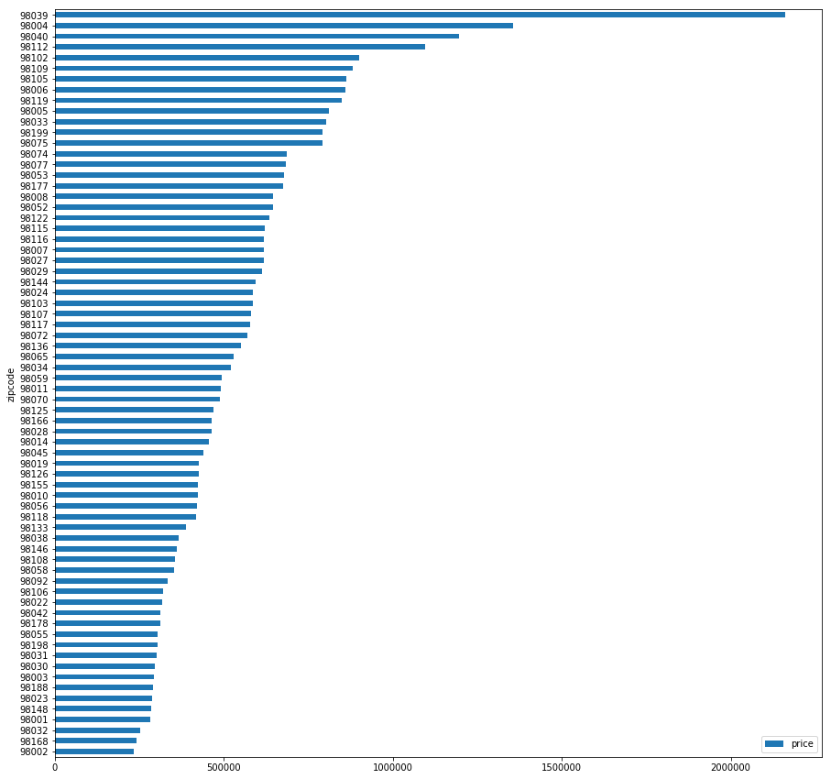




Influential Factor: Your Zip Code

Slide 5
Influential Factor: Your Zip Code
Average home value varies greatly depending on which Zip Code you reside in.
Many other factors can play into the area desirability(Crime, Proximity to School Systems, Appearance, etc)

Slide 6
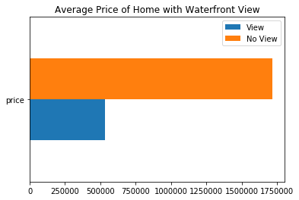
Influential Factor: Waterfront View
Having a view dramatically increases the home value regardless.
There is a correlation with Zip Codes as well for home near a body of water.
There is an almost 1.5M increase in average home price for waterfront view alone.

